Slide 1
Loan Risk - Technical Presentation
By: Jacob Lloyd

Slide 2
What is the dataset?
Compiled dataset from Lending Tree
Dataset omits personal information
Outcome = Good or Bad (902 & 323)

Slide 3
Cleaning/Data Processing
23 Duplicated rows - dropped
No missing values
No outliers that needed to be removed

Slide 4
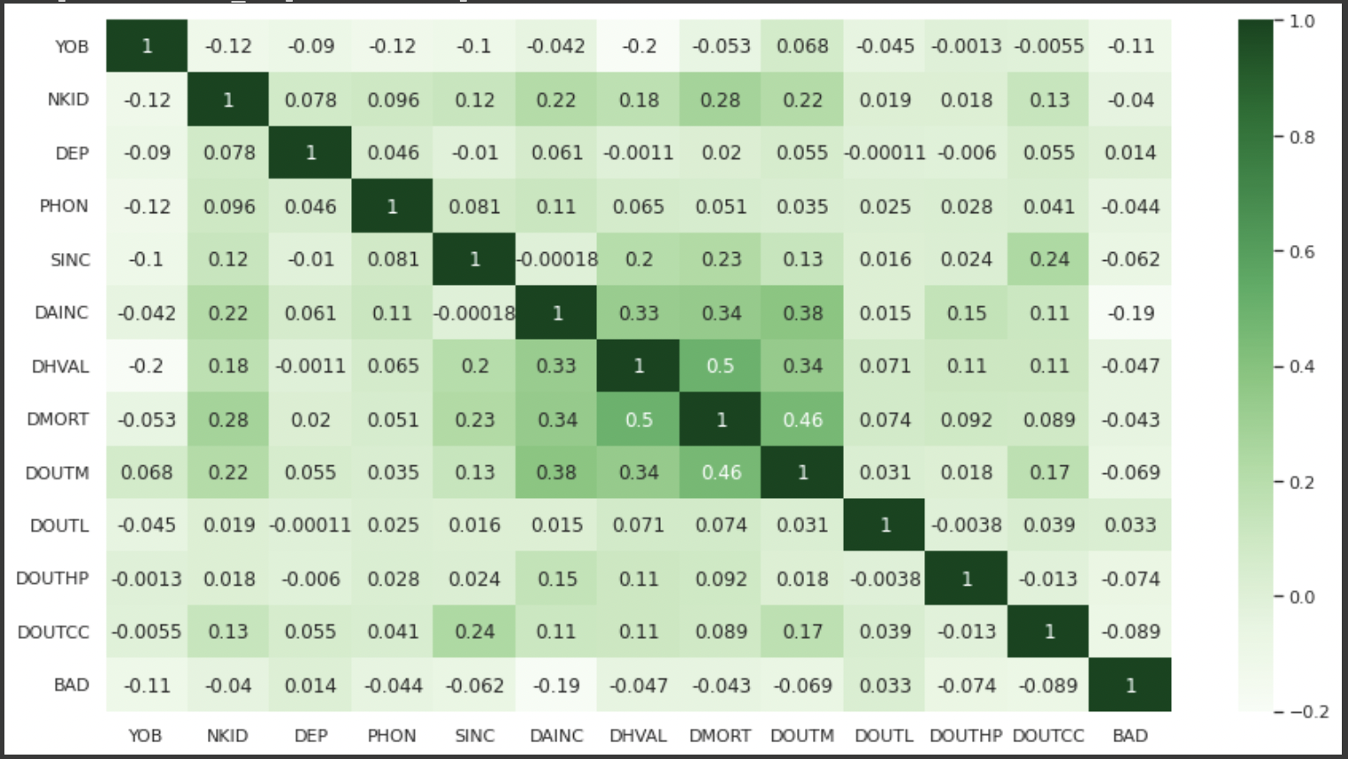
Data Visuals - 1

Slide 5
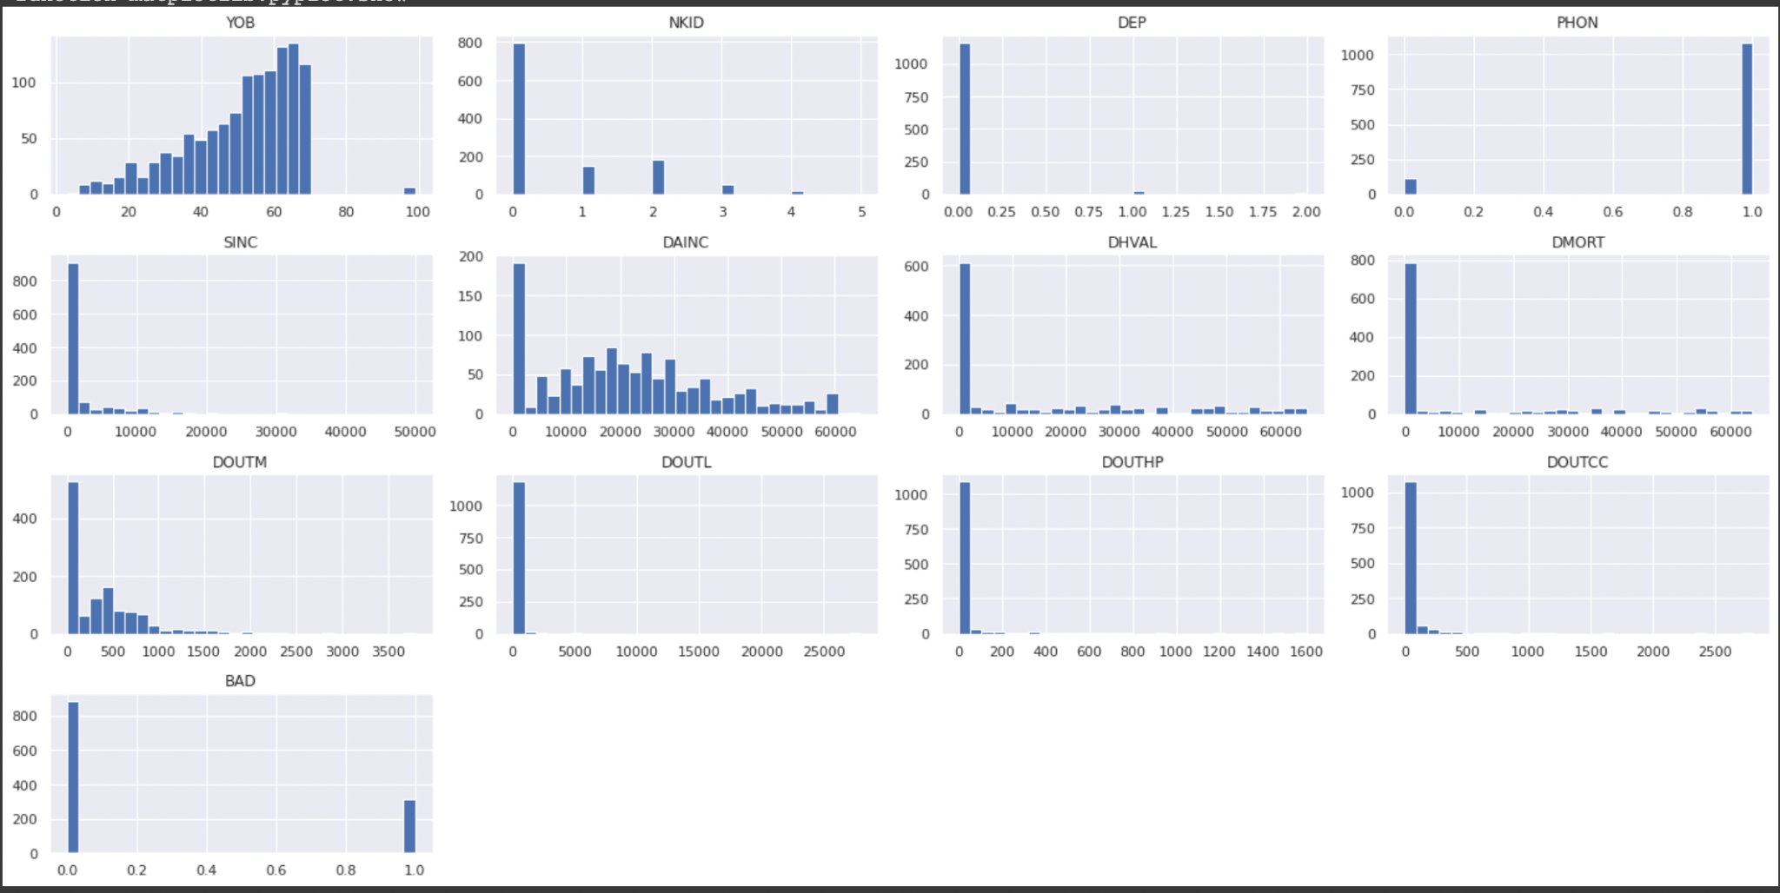
Data Visuals - 2

Slide 6
Upcoming Challenges
Relatively low data amount for this task
Ratio of good vs bad
Skewed models

